Slide 1

Cash and Working Capital Management Forecasting Assessment Guidance
The full scope of Cash and Working Capital Management (CWCM) services is not permissible for SEC audit clients and their affiliates or IFAC PIE audit clients and their related parties. CWCM services are generally permissible for IFAC non-PIE audit clients subject to evaluating engagement circumstances using the conceptual framework (i.e. threats and safeguards approach) and provided we do not assume a management responsibility as outlined in the Global Quality & Risk Management Manual Chapter 11. See detailed guidance regarding Independence on slides 11-16 of the CWCM methodology guide.
RESTRUCTURING
August 2008
ADVISORY
For the purpose of this document, all references to KPMG International, a Swiss cooperative that serves as a coordinating entity for a network of independent member firms operating under the KPMG name, will be referenced as KPMG International. Throughout this document, "KPMG" ["we," "our," and "us"] refers to the local, independent KPMG member firm or firms. Throughout this document “client” [“they,” “their and “them”] refers to the local, independent member firm’s client. KPMG International provides no client services.

Slide 2
Index
Topics covered Slide number
Purpose of this document Slide 2
Forecasting engagement overview Slide 3
Forecasting review
  Introduction Slide 4
  Kick-off project and submit information request Slide 8
  Analyse forecasting process Slide 10
Acronyms Slide 19

Slide 3
Purpose of this document
  The purpose of this document is to provide practitioners with guidance on how forecasts can be analysed, and how observations and recommendations to improve the forecasting process can be reported to client management. This guidance is not meant to be comprehensive. This document should be used as a reference tool and lays down guidances that are considered to be leading practices.
  We are regularly asked to comment on cash-flow forecasting processes within businesses. These requests can come from management and/or investors in the businesses e.g., Private Equity houses. The purpose of these requests are to strengthen existing forecasting processes and/or introduce new forecasting processes.

Slide 4
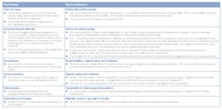
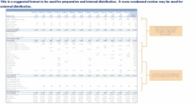
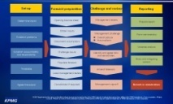
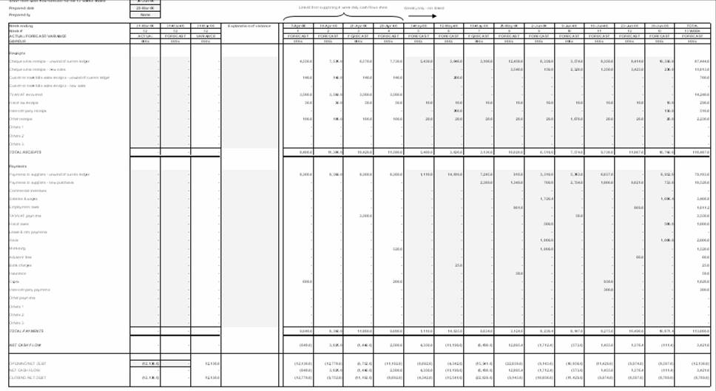
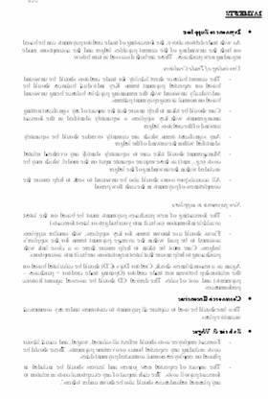
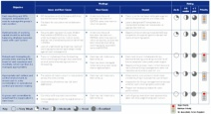
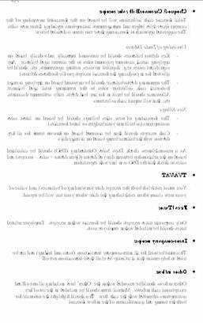
Cash and Working Capital Management for Corporates and PE
Forecasting – Overview
The typical approach during a forecasting – non-crisis engagement can be summarised as follows:
This document covers these areas
Project kick-off and information request
1
Forecasting assessment
2
Evaluation and development of recommendations
3
Group treasury and review
KPMG experience/ benchmarks
Develop revised forecasting process
4a
Current state assessment
Group requirements
Business unit involvement
Business unit reviews
Process design
Revised forecasting process
Forecast roll-out
4b
KPMG prior experience
Pilot entity trial
Re-forecasts
Monitoring and support
Roll out to other businesses
Example Output
Key findings
Case for change
Design layout
Leading practice
Forecasting process
Tools
Instructions

Slide 5
Introduction
  The primary area of focus in this document is around the short-term forecasts where typically companies do not prepare them, or if they do, they are usually not reliable.
  In general, we find that larger companies will usually have the following in place:
    Treasury forecasts
    Long-term cash-flow forecasts
  Mid-market sized companies will usually have some form of short-term forecast (not always receipts and payments basis) and a budget for the current financial year.
  We would recommend process improvements required to improve accuracy and reliability in respect of these forecasts. This would follow the principles of good forecasting set out on slide 6. Assistance and input may also be required from colleagues in Treasury and Financial Management, both in terms of recommendations and implementation.
  Ideally, companies would have three forecasts as follows, which should all reconcile:
Forecast | Length | Rests | Purpose
Treasury forecast | Usually two to four weeks | Daily | Used by Treasury to manage short-term liquidity and in particular investment decisions
Short-term receipts and payments forecast | Usually 13 weeks | Daily or weekly | Used by finance to manage medium-term liquidity and operational performance
Long-term funds flow forecasts | Twelve to twenty four months | Monthly | Used by management for long-term planning and financing decisions

Slide 6
Benefits and principles
  The preparation of a short-term receipts and payments cash-flow forecast will identify for client management:
    Key cash drivers and trends in the business
    Sensitivities and risks
    Potential opportunities to increase headroom
  The potential benefits of a short-term cash-flow forecast include:
    The key drivers of a company’s cash flow and highlights the controls required to deliver the forecast result are identified
    Client management may proactively manage the cash flow as they have visibility of potential issues in advance
    Trends in the business and possible opportunities to drive out headroom are identified
    It is a key element of embedding a cash culture within a business
Principles of a successful cash-flow forecasting process
  Possible key success factors in successful cash-flow forecasting processes are:
    The forecast should be properly set-up e.g., by development of templates, instructions, etc.
    The forecast should be anchored to a balance sheet with further inputs to the cash-flow forecast received from the “owners” of those areas across the business.
    Assumptions should be documented with local and senior management challenge
  Variance analysis of forecast against actual and forecast against reforecast should be undertaken.
  A commentary should be prepared covering key items and assumptions.
  For some line items in a forecast it is sometimes sensible to have a trade-off between 100% accuracy and timeliness of information. For example, the opening cash balance should be accurate, but overhead expenditure could be based on reasonable assumptions rather than perfection.

Slide 7
Project drivers and client requirements
Project drivers
  It is important to understand the drivers behind a cash-forecasting project. Understanding the needs of senior management or other key stakeholders will allow for better communication across the project, such as when discussing the project with content providers/inputters and the forecast compilers.
  Commonly encountered drivers include:
    Need to obtain funding
    Need to reduce non-utilisation fees on facilities
    Need to record visibility over future cash demands. This may be important to:
      Group-level management
      Local-level management
      Lenders
      Private equity owners
    Need to set targets and incentives (especially alongside a cash management/generation programme)
    Need to make announcements to investors
    Need to gain control over overseas entities
    Need to understand cash demands to allow for funds to be identified for growth or investment

Slide 8
Project drivers and client requirements (cont.)
Client requirements
  Once the drivers are understood, it is important to appreciate the requirements of the client so that the output can be tailored to suit client management’s day-to-day requirements. In order to do this, we would usually meet and discuss this with the following people:
    Project sponsor
    Group finance management team
    Group treasury (where applicable) management team
    Key business unit finance and senior management teams
    Key compilers/inputters
  There may be conflicting requirements and demands which will need to be addressed with the project sponsor. These may include:
    Speed versus accuracy of preparation
    Manual versus automation of input/output

Slide 9
Kick-off project and submit information request
General
  It is important to make clear that the review is focused on process and output and that it is not an audit of any particular forecast and whether the forecast result will be achieved.
  The meeting will be typically with the CFO and/or CEO.
  At the first meeting with the client, it is important to:
    Understand the trigger for our potential involvement
    Explain KPMG’s process and approach
    Determine the role we are required to undertake
Objectives
  Gain an overview of the business
  Identify key cash drivers and flows of cash
  Identify client personnel who prepare budgets and forecasts
  Determine what forecasts are prepared by the business:
    Treasury?
    Short-term?
    Long-term?
  Establish senior management’s views on the existing forecast output and areas for enhancement
Key questions:
  What has triggered client’s concerns?
  Are there specific categories in the forecasts which frequently miss their target?
  What is currently lacking from the forecasts?
Outcome
  The desired outcome from this meeting is to:
    Obtain agreement to start the standard process we ideally follow (see slide 5)
    To meet with the client staff who prepare/ review the forecasts
    Obtain all latest forecasts with supporting information
  In addition it is important to agree the form of assistance we give and the output from that assistance. The output can be:
    Verbal advice and forecasting action plans; or
    A detailed deliverable providing comment and recommendations in respect of:
      The forecasting process
      People involved
      Internal and external benchmarking
      Existing forecasts and their limitations/ risks
      User needs
      Recommendations and suggested new output
      Next steps
      Other relevant issues

Slide 10
Kick-off project and submit information request (cont.)
A typical information request list is likely to include:
  Annual budget and forecast updates:
    Copy of latest budget pack and subsequent revisions (these are often revised quarterly)
    Copy of group budgeting instruction manual
    Copy of prior year’s budget, updates, and actual results
  Short-term forecast (where available):
    Copy of latest short-term cash-flow forecast
    Group short-term forecasting instructions document
    Recent historic cash-flow forecasts and actuals
  Treasury forecast (where available):
    Copy of latest treasury forecast
    Recent treasury forecasts and actuals
    Group treasury forecasting instructions document
  Other information:
    For the forecasts collected, request details of:
      Typical timetable and recent record of delivery to timetable
      Persons involved in the process in both generation, consolidation and review
      A listing of the users/circulation list for the output
    Most recent management accounts
  Other considerations:
    Seek to obtain forecasts in soft copy to assist review process

Slide 11
Analyse forecasting process
  In undertaking an analysis of cash-flow forecasting within a business, we help the client understand:
    What types of cash-flow forecasts are prepared?
    What is the timing and frequency of such forecasts?
    What is the basis of preparation used in each of the forecasts?
    What instructions and templates are in place to give guidance on preparing those forecasts?
    Who inputs into the preparation of the forecasts?
    What is the historical accuracy of each of the types of cash-flow forecasts prepared?
    Are each type of cash-flow forecasts reconciled?
  Once we have established and understood the above, we are then in a position to comment on whether:
    All cash-flow forecasts that should be prepared are being prepared
    Cash-flow forecasts are truthful
    Forecasting processes are robust

Slide 12
Analyse forecasting process
Commonly encountered forecasts
  Below are outlined a number of different types of forecast which have been used by clients in a short term context.
Type of forecast | Description | Comments
Closing balance forecast | Shows only the closing bank balance with no other detail | Not detail to back up the forecast Cannot undertake variance analysis No ownership of line items
EBITDA forecast | Assumes that EBITDA equates to cash flow | Ignores movements in main working capital accounts Ignores irregular/non monthly line items, e.g., quarterly rents, annual prepayments Who is responsible for delivering EBITDA?
Funds flow | Based on a source and application of funds | Better than EBITDA as it includes working capital movements Ownership of line items including operating profit and working capital items is lacking Usually simplistic assumptions used in respect of difficult to forecast line items (e.g., flat prepayments, no movement in stock, flat deferred income) Difficult to understand the drivers of variances
Run rate | Receipts and payments are based on historic run rates | Has some merits in certain circumstances (e.g., high volume of low value transactions, retail sales, smaller value line items) Lacks granularity and it is difficult to understand variance analysis Can create large timing variances as people often take a monthly rate and divide by four Tends not to take into account seasonal fluctuations
Automated/ System generated | Produced as a function of an IT/ accounting system | Depends largely on the quality of data held (e.g., customers’ and suppliers’ payment terms) Assumes everything on ledgers is due and payable. Ignores disputes, customers’ actual payment history, etc. Lack of ownership/responsibility for its production Tends to reflect a theoretical cash position rather than an actual

Slide 13
Analyse forecasting process
Forecast review activities
Group and Treasury
review
Business unit
reviews
Benchmarks: Internal
comparisons
Benchmarks: External comparisons
Other KPMG experience
Establish what forecasts are prepared and who uses them
Review historic forecasting accuracy to identify “weak” points
Meet group treasury to review treasury forecasting processes
Meet group finance/ business planning to review planning and forecasting framework and processes
Understand Capital Expenditure (Capex) programme and controls
Establish what group-wide instructions have been issued for each flow forecasting and assess their adequacy
Establish timing and frequency of cash-flow forecasts
Build overall picture of how all cash-flow forecasts are prepared, their accuracy and key forecasting process sensitivities
If needed, meet other relevant group functions (such as sales, purchasing, etc.) and establish their input into the process
Identify key business units for review
  Understand how cash flows around a business through meetings functional heads including:
  Sales
    Purchasing
    Operations
    Inventory management
    Capital Expenditure
    Understand the forecasting process by meeting:
      Principal staff that give input
      Compilers
      Reviewers
  Determine basis or preparation of all cash-flow forecasts prepared
  Establish timing and frequency of cash-flow forecasts
  Establish recent accuracy of cash-flow forecasts
  Assess cash-flow forecasting instructions and assess against better practice
  Identify best and worst performers in terms of accuracy of cash-flow forecasting
  For the best and worst performers, understand the differences between:
    Use of the forecasts
    Basis of preparation
    Who is involved and who inputs into the forecast
    Split of responsibilities
    Challenge and review process
  The above information can be used to feed into the recommendations for improvement
  Consider roll-out of internal better practice
  Compare forecasting process to experience gained working with similar businesses in the same sector and of the same presence and size.
  Identify key differences in the forecast to feed into the recommendations for improvements:
    Use of the forecasts
    Basis or preparation
    Who is involved and inputs to the forecast
    Split of responsibilities
    Challenge and review process
  The above information can be used to feed into the recommendations for improvement.
  Consider the involvement of the following KPMG staff:
    Treasury for Treasury forecast
    Financial Management for long-term forecasts
    Modelling group for complex client models
  These may result in additional costs and early communication to the client as well as internally to help ensure these resources are available.

Slide 14
Analyse forecasting process
Forecasting considerations
  The following information provides guidance on the areas typically analysed or considered during a analysis of a forecasting process and whether these aspects are applicable for:
    A treasury forecast
    A short-term cash-flow forecast
    A long-term cash-flow forecast
Developing recommendations
  The points to consider and questions below will assist in identifying weaknesses and gaps in the forecasting processes. Once these have been identified our recommendations can be developed which will enable the weaknesses to be remedied and move the organisation towards our experience of forecasting good practices.
  This will allow a more robust forecasting process to be implemented by the client.

Slide 15
Analyse forecasting process
Forecasting considerations (cont.)
Forecasting considerations
Area | Points to consider | Applies to all | Applicable
 |  |  | Treasury | Short-term | Long-term | Comment
Process | Standardised group wide documented instructions | Y |  |  |  | What checks are there?
 | Consolidation process – automatic | Y |  | ? | ?
 | Consolidation process – manual
 | P&L, Balance sheet, Cash balancing ? |  |  |  | Consistent approach available?
 | Group review, challenge, etc. | Y
People | People closest to data forecasting | Y |  |  |  | If so needs widening out
 | Local review, feedback and adjusting | Y
 | Is it just a finance process
 | Are in-putters identifiable (named) from the output sheets? | Y
 | Is there cross discipline challenge – e.g., cash committee | Y
Distribution | Who receives the output |  |  |  |  | Does it meet user needs?
 | Is there evidence of usage/feedback to compilers |  |  | Y | Y | Accuracy likely to suffer if no feedback
Anchor points | Latest set of bank balances | Y
 | Latest balance sheet |  |  | Latest monthly accounts
 | Forecast balance sheet - reconcile from now to opening |  |  |  | Budgets usually start in a new year before balance sheet known

Slide 16
Analyse forecasting process
Forecasting considerations (cont.)
Forecasting considerations
Area | Points to consider | Applies to all | Applicable
 |  |  | Treasury | Short-term | Long-term | Comment
Cash balances | Is trapped cash separately identified? | Y |  |  |  | May become available Cannot pay wages with trapped cash
 | Are the reasons for it being trapped noted | Y
Documentation | Assumptions documented ? | Y |  |  |  | Aids understanding and reduces questions Allows forecast to be flexed Allows forecast to be flexed
 | Are key risks/sensitivities documented? | Y
 | Are potential upsides documented? | Y
Source data | AR ledger for unwind |  | ? | Y
 | Are non-collectable items excluded |  | ? | Y
 | AP ledger for unwind |  | ? | Y
 | How often are payments made |  | ? | Y
 | Use of order book in forecasting process |  | ? | Y
 | Use of Goods Received Not Invoiced (GRNI) |  | ? | Y
 | Is there a sales/ transaction pipeline? |  | ? | Y
 | Are accruals unwound |  | ? | Y
 | Is WIP unwound? |  | ? | Y
 | Known payment runs Payroll information required |  | Y ? | Y
Submissions | Detailed receipts and payments based |  | Likely | Essential | Unlikely | Net flows mask potential risks Do people read the output Consistency should help completeness
 | Is it just a net flow? |  |  | Often seen
 | How big is the pack? | Y
 | Are entity submissions consistent (content) | Y
Rests | Daily |  | Usual | Possibly
 | Weekly |  |  | Usual
 | Monthly |  |  |  | Usual

Slide 17
Analyse forecasting process
Forecasting considerations (cont.)
Forecasting considerations
Area | Points to consider | Applies to all | Applicable
 |  |  | Treasury | Short-term | Long-term | Comment
Duration | Typical 2-8 weeks daily |  | Y |  |  | Likely to be linked to investing duration Captures quarterly payments Visibility decreases throughout the year
 | 13 weeks typical, possible 17 weeks if updated monthly |  |  | Y
 | Rolling 12 months or just to end of year typical |  |  |  | Seek rolling 12 months/ longer forecasts
Updating | Daily typical |  | Y | Sometimes
 | Weekly/monthly typical |  |  | Y |  | In non-crisis there are cost/benefit considerations
 | Quarterly typical |  |  |  | Y
 | Is the reforecasting process as thorough as the original forecast? |  |  | Y |  | Mid month may not be as thorough
 | Are reforecasts focussed on key items only? |  |  | Y |  | Mid month may not be as thorough
 | Are original forecasts kept or overwritten daily/periodically? | Y |  |  |  | Difficult to track variances if they are overwritten
Variances | Daily typical |  | Y |  |  | Variance analysis drives accuracy
 | Weekly/monthly typical |  |  | Y |  | (as noted elsewhere)
 | Quarterly typical |  |  |  | Y
 | Is there evidence of actions following variance analysis | Y

Slide 18
Analyse forecasting process
Forecasting considerations (cont.)
Forecasting considerations
Area | Points to consider | Applies to all | Applicable
 |  |  | Treasury | Short-term | Long-term | Comment
Funds flows | Typically the product in a medium term forecast |  |  |  | Y | What working capital assumptions have been made
 | These points are also relevant to short-term receipts and payments forecasts |  |  |  | Y | Has there been a sense check of implicit DSO/ DPO/ DIO
 |  |  |  |  | Y | Do assumptions reflect historic seasonal patterns
 |  |  |  |  | Y | Do assumptions reflect changes in the business model
 |  |  |  |  | Y | Do assumptions reflect known business issues
 |  |  |  |  | Y | What financing assumptions have been made
Models |  |  |  |  |  | Is the model integrated fully
 | How complete are the models? Are templates consistent across units? | Y Y |  |  |  | Does the model need IRM (or similar) to review Who built the model?
Reconciliations | Can the three forecasts be reconciled? | Y |  |  |  | Should do this but often is not performed
Run rates | Run rates may be reasonable, but often need checking | Y |  |  |  | Are run rates in evidence?
 |  |  |  |  |  | What are the assumptions?
 |  |  |  |  |  | Are they reasonable given historic cash flows?

Slide 19
Analyse forecasting process
Forecasting considerations (cont.)
Forecasting considerations
Area | Points to consider | Applies to all | Applicable
 |  |  | Treasury | Short-term | Long-term | Comment
Historic actuals | A sense check of historic data to the forecast data should be undertaken | Y |  |  |  | Having obtained actual daily flows:
 |  |  |  |  |  | Do the actuals contain data on more line items than the forecast?
 |  |  |  |  |  | Do the actuals have more frequent flows than the forecast?
"Other" | Does the “other” forecast line item have bigger flows than identified line items? | Y |  |  |  | If so - they should be disaggregated and forecast separately
Excel data | Are the numbers in the forecast hard coded | Y |  |  |  | What is the back up ?
 | Are the numbers summations of several numbers with no explanation | Y |  |  |  | What are the component numbers ?

Slide 20
Acronyms
ABL | Asset Based Lenders
ADD | Average Days Delinquent
AP (A/P) | Accounts Payable
AR (A/R) | Accounts Receivable
BACS | Bank Automated Clearing System
BPDPO | Best Possible Days Payable Outstanding
BPSO | Best Possible Days Sales Outstanding
CAPEX | CAPital EXpenditure
CIS | Contracts Information System
COD | Cash On Delivery
CRA | Credit Rating Agency
CRO | Chief Risk Officer
DAO | Days Accrued Outstanding
DB | Defined Benefit
DC | Defined Contribution
DD | Direct Debit
DIA | Days of Inventory Available
DIH | Days Inventory Held
DIO | Days of Inventory Outstanding
DPO | Days Payable Outstanding
DSO | Days Sales Outstanding
DUO | Days Unbilled Outstanding
EBITDA | Earnings Before Interest, Tax, Depreciation and Amortization
EDI | Electronic Data Interchange
FX | Foreign Exchange
GRNI | Goods Received Not Invoiced
G/L | General Ledger
HMRC | Her Majesty's Revenue and Customs (UK)
LIBOR | London Interbank Offered Rate
NIC | National Insurance Contributions
NPD | New Product Development
PAYE | Pay As You Earn
PE | Private Equity
PPF | Pension Protection Fund
R&D | Research and Development
ROCE | Return On Capital Employed
ROI | Return On Invested Capital
SKU | Stock Keeping Unit
SO | Standing Order
SoC | Schedule of Contributions
STCF | Short Term Cash Flow forecast
VAT | Value Added Tax
VMI | Vendor Managed Inventory
WIP | Work in Progress

